Slide 1
WELCOME

Slide 2
Group members
Muhammad Sajid Bsef18m039 (Team leader)
Muhammad Saqlain Bsef18m038 (Team member)
Rafiuddin Bsef19m046 (Team member)

Slide 3
Presentation on GB DryFruits
Gb dry fruit in 3d w.r.t pics

Slide 4
Introduction
About Our project

Slide 5
Our System
Our System is an e-commerce platform where customers may purchase products online.
The administrator monitor user activity and validates transactions.

Slide 6
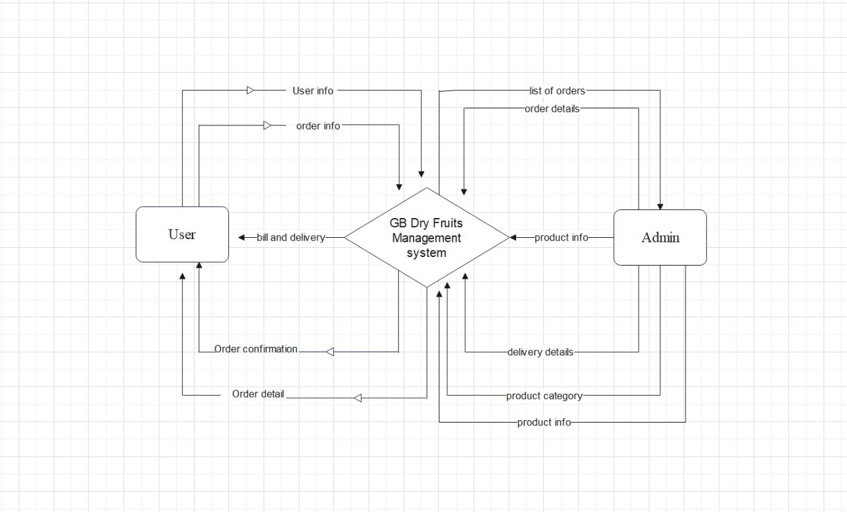
Process of GB DryFruits

Slide 7
Features:
Menu
Catalog Browsing
Category List
Product List
Catalog Management
Product Browsing
Product Reviews
Related Products
Shopping Cart
Checkout
Auto generated bill
Payment Gateway

Slide 8
Languages:
HTML
CSS
Bootstrap
Java script
MySQL
Tools:
Visual studio code

Slide 9
Data Flow Diagram

Slide 10
ADVANTAGES OF E-COMMERCE
Faster buying/selling procedure, as well as easy to find products.
Buying/selling 24/7.
More reach to customers, there is no theoretical geographic limitations.
Low operational costs and better quality of services.
No need of physical company set-up.
Easy to start and manage a business.

Slide 11
DISADVANTAGES OF E-COMMERCE
Unable to examine products personally.
Not everyone is connected to the Internet.
There is the possibility of credit card number theft.
Mechanical failures can cause unpredictable effects on the total processes.

Slide 12
Future plan
We are thinking of some modifications and adding some advanced new features in out system. Some of them are
GUI modification (more user friendly)
Users can sell their products
Users can signup / login using their social media account such as Facebook, google+ etc.
Regional Language support

Slide 13
GUI(Graphical User Interface)

Slide 14
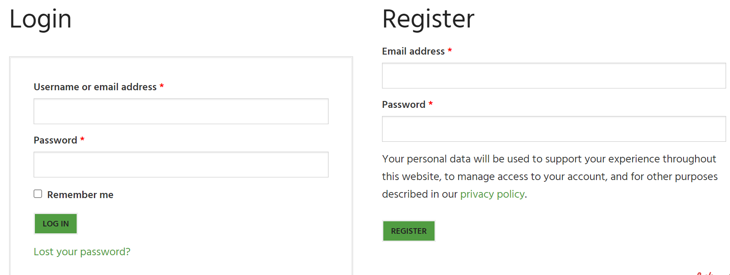
Login/Registration interface

Slide 15
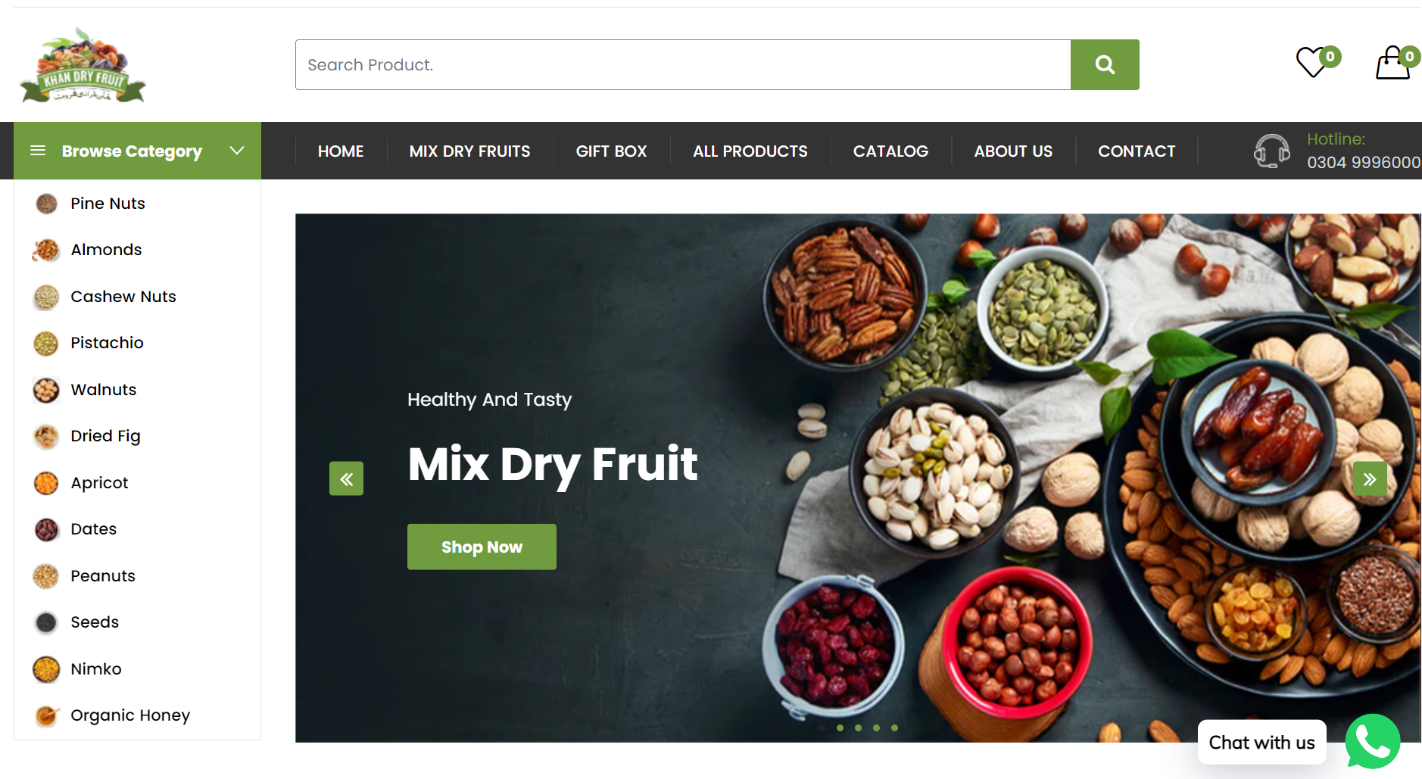
Home page

Slide 16
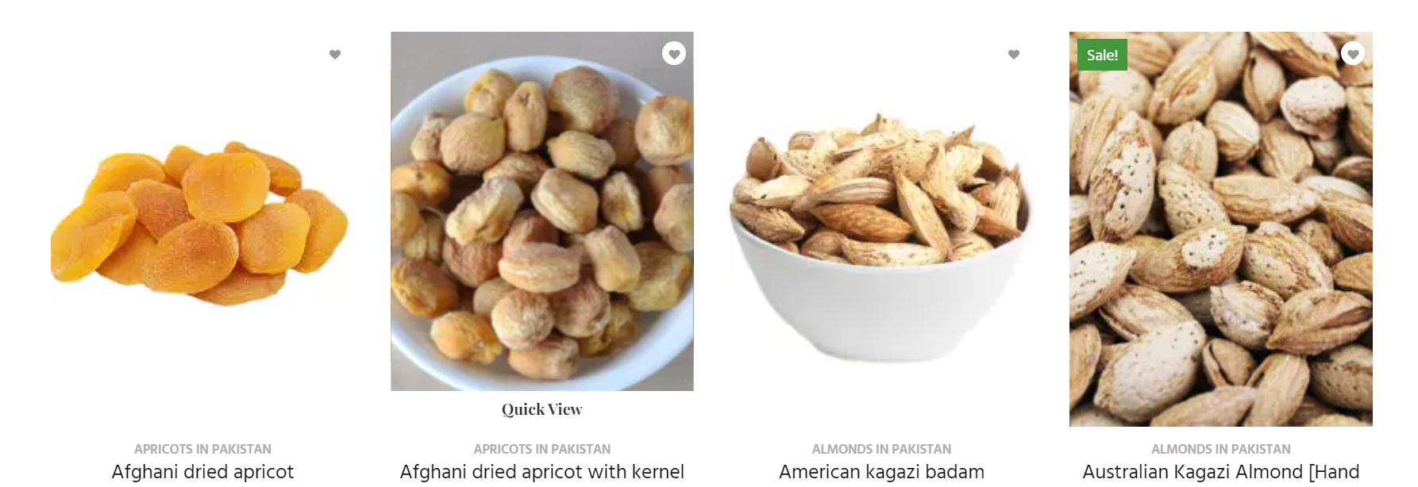
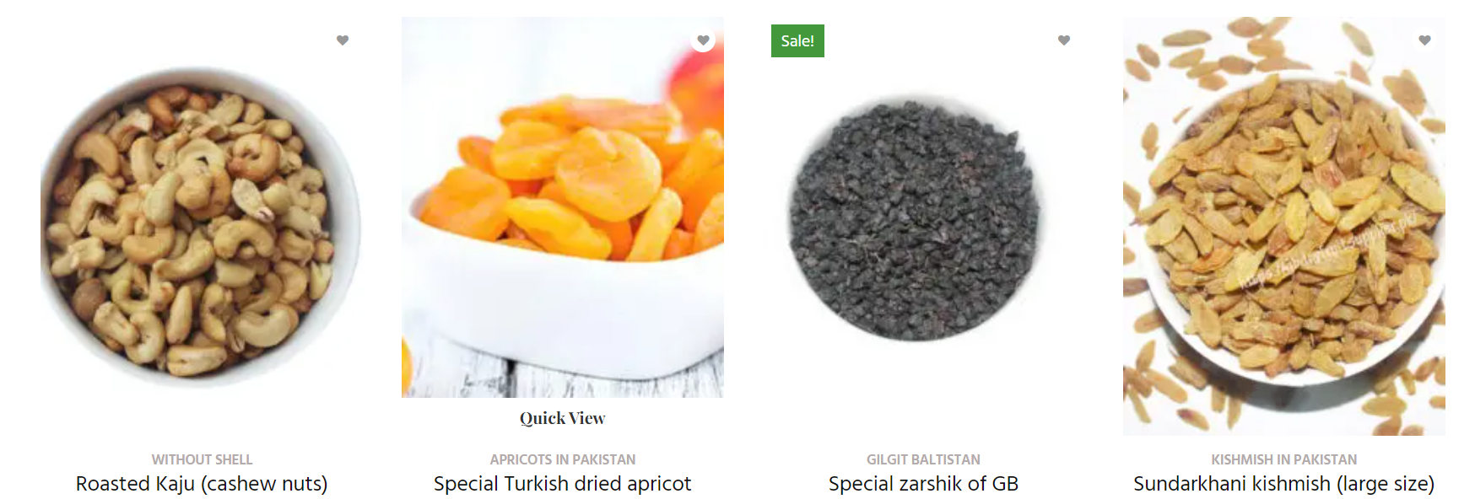
Products Interface

Slide 17
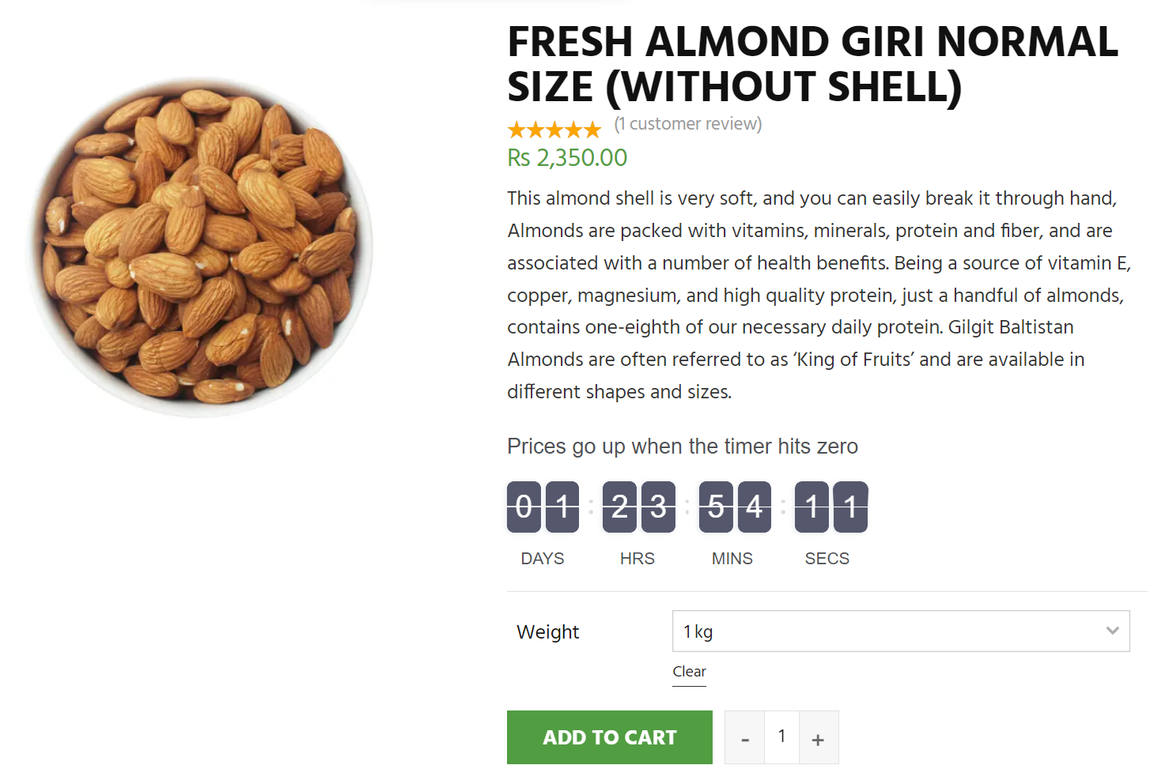
Single product Interface

Slide 18
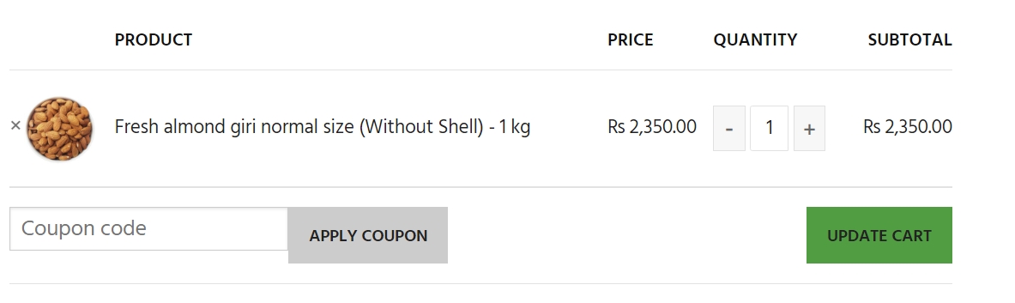
Cart interface

Slide 19
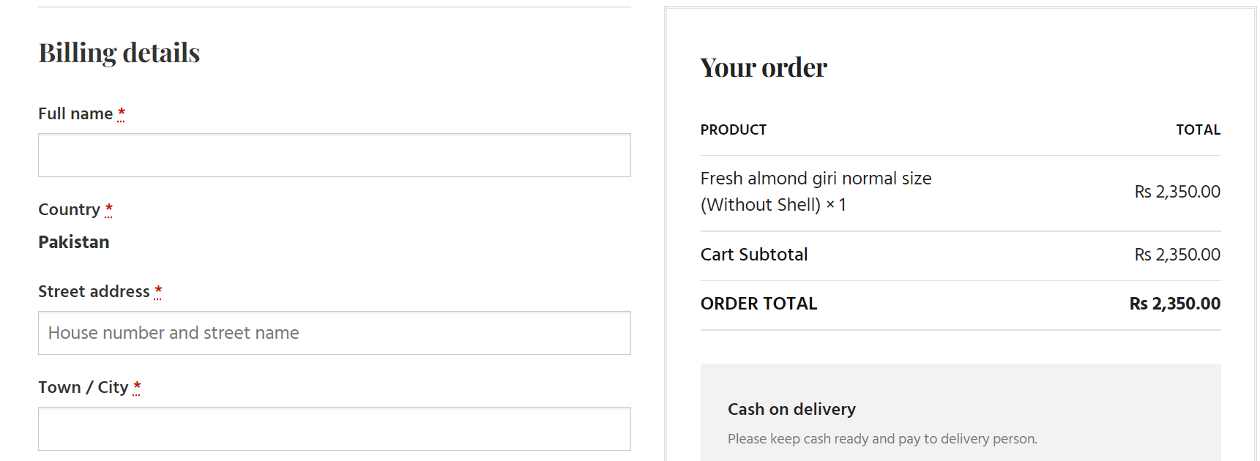
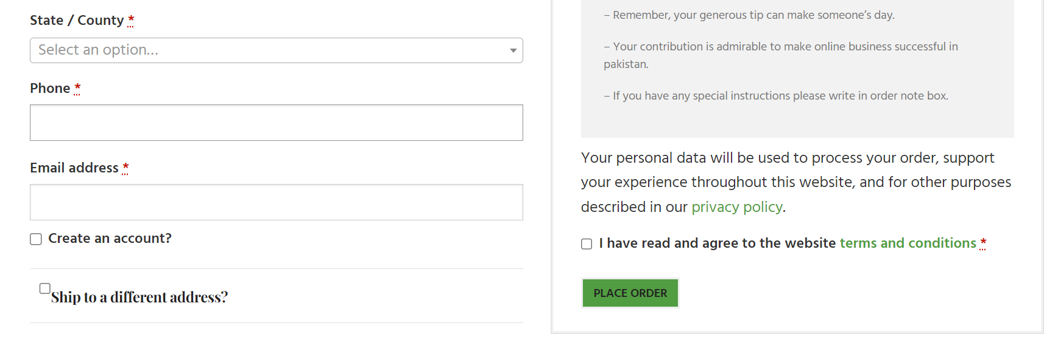
Checkout interface

Slide 20
Any Question?

Slide 21
Thank you!

